Slide 1
Set Up AWS CloudWatch for Monitoring and Alerts

Slide 2
Cloud Watch
Amazon CloudWatch is a service used for monitoring and observing resources in real-time, built for DevOps engineers, developers, and IT managers.
CloudWatch collects monitoring and operational data in the form of logs, metrics, and events, providing its users with an aggregated view of AWS resources, applications, and services that run on AWS.
The CloudWatch can also be used to detect anomalous behavior in the environments, set warnings and alarms, visualize logs and metrics side by side, take automated actions, and troubleshoot issues.

Slide 3
Why Amazon CloudWatch?
Amazon Cloud Watch is a monitoring service offered by Amazon Web Services to monitor applications like the following.
Performance.
Health of the application.
Monitors the resource use, etc.
You can set the alarm to the resource use of the applications when the limits are exceeded then you will get the notification to the mail automatically.

Slide 4
Terms associated with cloud watch
Dashboards: CloudWatch is used to create dashboards to show what is happening with your AWS environment.
Alarms: It allows you to set alarms to notify you whenever a particular threshold is hit.
Logs: CloudWatch logs help you to aggregate, monitor, and store logs.
Events: CloudWatch help you to respond to state changes to your AWS resources.

Slide 5
Cloud watch using Terraform
In the visual studio code create a new folder and take another new folder, create new files which are main.tf, variables.tf, terraform.tfvars, output.tf and give the code in the respective files as shown in the following slides to create cloud watch, SNS, dashboard.
Then, open new terminal to run the code, using the terraform commands which are •aws configure
•terraform init- initializes a terraform working directory by downloading and installing any required plugins and dependencies.
•terraform plan- Creates an execution plan, showing what actions Terraform will take to align the infrastructure with the configuration files.
•terraform apply- terraform apply command applies the changes defined in the configuration to your infrastructure. It creates or updates the resources according to the configuration.

Slide 6
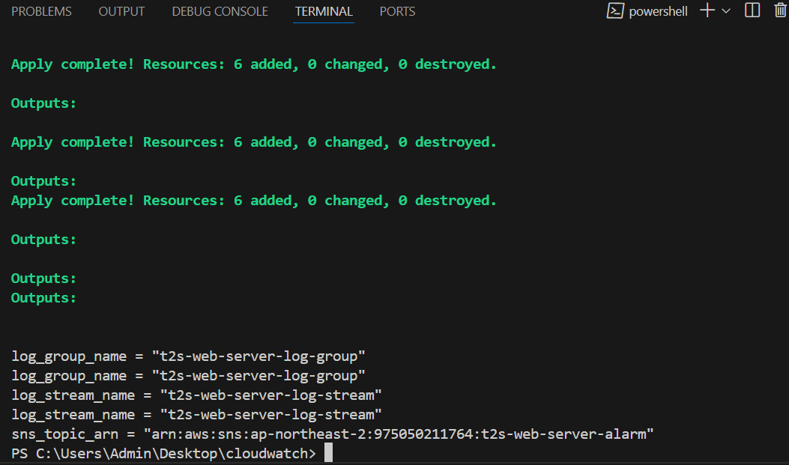

Slide 7
provider "aws" {
region = var.region
}
resource "aws_cloudwatch_log_group" "t2s_web_server_log_group" {
name = var.log_group_name
}
resource "aws_cloudwatch_log_stream" "t2s_web_server_log_stream" {
name = var.log_stream_name
log_group_name = aws_cloudwatch_log_group.t2s_web_server_log_group.name
}
resource "aws_cloudwatch_metric_alarm" "high_cpu_utilization" {
alarm_name = "HighCPUUtilization"
comparison_operator = "GreaterThanThreshold"
evaluation_periods = "1"
metric_name = "CPUUtilization"
namespace = "AWS/EC2"
period = "300"
statistic = "Average"
threshold = "80"
alarm_actions = [aws_sns_topic.alarm_topic.arn]
dimensions = {
InstanceId = var.instance_id
}
unit = "Percent"
}
resource "aws_cloudwatch_metric_alarm" "high_memory_utilization" {
alarm_name = "HighMemoryUtilization"
comparison_operator = "GreaterThanThreshold"
evaluation_periods = "1"
metric_name = "MemoryUtilization"
namespace = "System/Linux"
period = "300"
statistic = "Average"
threshold = "80"
alarm_actions = [aws_sns_topic.alarm_topic.arn]
dimensions = {
InstanceId = var.instance_id
}
unit = "Percent"
}
resource "aws_cloudwatch_metric_alarm" "low_disk_space" {
alarm_name = "LowDiskSpace"
comparison_operator = "LessThanThreshold"
evaluation_periods = "1"
metric_name = "DiskSpaceUtilization"
namespace = "System/Linux"
period = "300"
statistic = "Average"
threshold = "20"
alarm_actions = [aws_sns_topic.alarm_topic.arn]
dimensions = {
InstanceId = var.instance_id
}
unit = "Percent"
}
resource "aws_sns_topic" "alarm_topic" {
name = var.alarm_name
}
Main.tf

Slide 8
output "log_group_name" {
value = aws_cloudwatch_log_group.t2s_web_server_log_group.name
}
output "log_stream_name" {
value = aws_cloudwatch_log_stream.t2s_web_server_log_stream.name
}
output "sns_topic_arn" {
value = aws_sns_topic.alarm_topic.arn
}
Output.tf

Slide 9
region = "ap-northeast-2"
log_group_name = "t2s-web-server-log-group"
log_stream_name = "t2s-web-server-log-stream"
instance_id = "i-0be8135d8b837ecbf" # Replace with the desired Instance ID.
alarm_name = "t2s-web-server-alarm"
terraform.tfvars

Slide 10
variable "region" {
description = "The AWS region to deploy resources in"
type = string
default = "ap-northeast-2"
}
variable "log_group_name" {
description = "The name of the CloudWatch log group"
type = string
}
variable "log_stream_name" {
description = "The name of the CloudWatch log stream"
type = string
}
variable "instance_id" {
description = "The ID of the EC2 instance to monitor"
type = string
}
variable "alarm_name" {
description = "The alarm we deploy"
type = string
}
Variables.tf

Slide 11
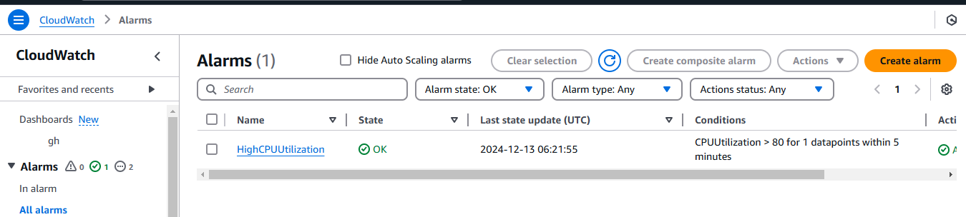

Slide 12
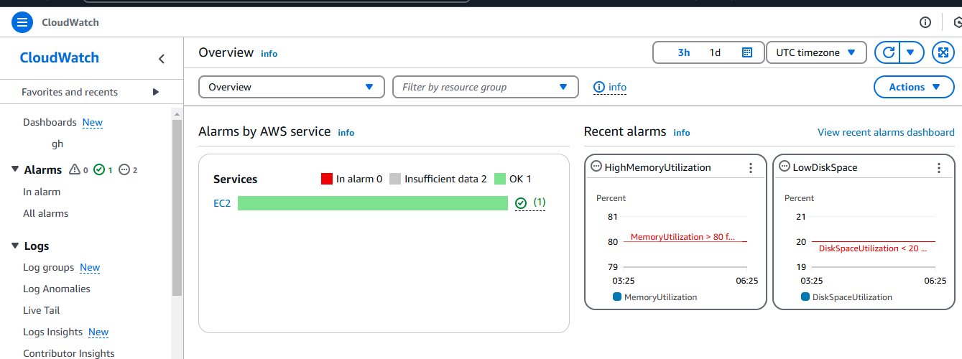

Slide 13
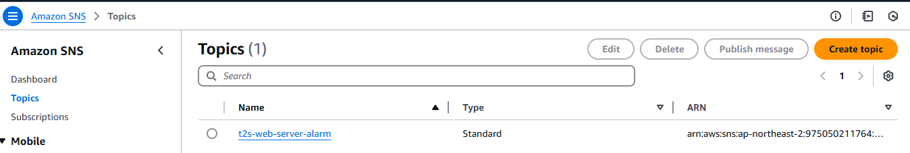

Slide 14
Thankyou

